Slide 1
Software-Defined Networking
Lecture X
CS 168, Fall 2024 @ UC Berkeley
Slides credit: Sylvia Ratnasamy, Rob Shakir, Peyrin Kao
Notes:
Slides template credit: Josh Hug, Lisa Yan

Slide 2
Software-Defined Networking: A Brief History
Software-Defined Networking
A Brief History
Implementation (OpenFlow API)
Benefits (Traffic Engineering)
SDN in Datacenters
Other Applications of SDN
Lecture X, CS 168, Fall 2024

Slide 3
What is Software-Defined Networking?
Software-defined networking (SDN) is a new way to think about network management.
So far: Routers each run a distributed protocol to compute paths.
What do we do if these protocols don't meet our needs?
Today: A centralized piece of code computes paths and gives them to routers.
SDN applies to other aspects of network management as well, but we'll focus on routing.

Slide 4
Innovating Routers
Suppose we want a specialized routing protocol for our own network.
Why is implementing it hard?
Routers are standardized.
We have to submit our change to a standards body.
We might have to wait years for them to approve it.
Routers are inflexible.
Major vendors want to implement solutions that work well for everybody.
If nobody else wants our protocol, vendors won't build it.
Routers are vertically integrated.
The data, control, and management planes are all wired on the chips.
No easy way to swap out specific parts of the router.
Similar problems if we want to experiment.
Vendors don't want to build something that might not work.

Slide 5
Innovating Routers
Routers are standardized, inflexible, and vertically integrated.
The data plane is highly standardized.
Recall: The data plane forwards packets.
Routers from different vendors need to send bits on the wire in the same consistent format.
Not much to innovate here (mostly faster speeds).
Developed by an equipment vendor.
Management Plane
Control Plane
Data Plane

Slide 6
Innovating Routers
Routers are standardized, inflexible, and vertically integrated.
The control plane is mostly standardized.
Recall: The control plane runs routing protocols.
Some extensions exist, but routers from different vendors ultimately need to follow the same routing protocol.
We want to innovate by creating our own routing protocols.
Developed by an equipment vendor.
Management Plane
Control Plane
Data Plane

Slide 7
A Brief History of SDN
Researchers and network operators began to think about how to better control the network.
This led to some radical thinking about how to redesign routers!
A Clean Slate 4D Approach to Network Control and Management |  | Link
Albert Greenberg et. al. | 2005
Today's data networks are surprisingly fragile and difficult to manage. We argue that the root of these problems lies in the complexity of the control and management planes.

Slide 8
Radical Idea: Disaggregating Routers
Radical idea: Split the network planes apart.
Each plane has an API that communicates to the plane below it.
Allows for more customization and innovation at the control plane.
Management Plane
API
Control Plane
API
Data Plane

Slide 9
Radical Idea: A New View
Radical idea: A totally new system architecture that splits up the three planes.
Operator receives a network abstraction (e.g. graph) from the OS, and computes routing decisions.
Allows the operator to use their own routing protocol.
Control Program
Network OS
Provides a network abstraction (e.g. graph) to the operator.
Takes the operator's decisions and uses them to program routers.
Commodity routers that forward based on operator decisions.
Can be cheap – they don't need to compute routing protocols.

Slide 10
A Brief History of SDN
Separating the control and data planes isn't a new idea.
2003: IETF created a working group to study this concept.
Forwarding and Control Element Separation (ForCES).
Didn't get significant momentum.
2004: New management paradigms being researched.
RCP, 4D at Princeton, CMU. SANE, Ethane at Stanford, UC Berkeley.
2008: More momentum. OpenFlow interface at Stanford, Nicira.
2011: Industry acceptance. Open Networking Foundation (ONF) created with tech companies (Google, Microsoft) and vendors (Cisco, Juniper, HP, Dell).
Nicira OpenFlow: Networking's Next Big Thing? |  | Link
Charles Babcock | February 4, 2012
$40-million startup emerges with OpenFlow platform for virtualizing the network as effectively as servers.

Slide 11
Implementation: OpenFlow API
Software-Defined Networking
A Brief History
Implementation (OpenFlow API)
Benefits (Traffic Engineering)
SDN in Datacenters
Other Applications of SDN
Lecture X, CS 168, Fall 2024

Slide 12
OpenFlow API
To separate the control and data plane, we need an API.
The operator runs its own fancy code and outputs routing decisions.
The operator installs these routes onto the forwarding chips.
We need a specific format for these decisions that both operators and chips understand.
Control Plane
(operator code)
API
Data Plane
(commodity routers)

Slide 13
OpenFlow API Format – Flow Tables
The basic building block is a flow table, a more generalized forwarding table.
Maps matches to actions.
Matches can include more than just the destination IP.
Example: 5-tuple to match a specific flow.
Actions can be more than just sending to a specific next-hop.
Example: Encapsulation and decapsulation.
Example Flow Table
Match: | Action:
Destination IP is in 192.168.0.0/16 | Forward to next-hop R2
5-tuple is exactly (1.1.1.1, 2.2.2.2, TCP, 255, 53) | Add encapsulation and forward to R3
Source IP is exactly 10.2.15.3 | Decapsulate and forward to R3

Slide 14
OpenFlow API Format – Flow Tables
The operator writes routing decisions as a sequence of numbered flow tables.
Each table maps matches to actions, just like we saw.
Packet is matched against each table in order, and actions are added.
Could add special actions like "skip to Table 2," or "clear all actions so far."
When we reach the last table, all actions are applied (e.g. packet is sent out).
You don't need to know the exact syntax, just the general idea.
Table 0
Table 1
Table 2

Slide 15
OpenFlow API Format – Flow Tables
Flow tables are still constrained by what forwarding chips can do in hardware.
In practice, matches tend to be similar to "classic" forwarding tables.
Longest-prefix matching on destination IP addresses.
Policy-based routing on 5-tuples.
Exact match on virtual network ID.
Remember: The advantage is letting the operator decide the policies.
Control Plane
(operator code)
Table 2
... | ...
... | ...
Table 1
... | ...
... | ...
API: OpenFlow
Table 0
Match: | Action:
... | ...
Data Plane
(commodity routers)

Slide 16
Benefits (Traffic Engineering)
Software-Defined Networking
A Brief History
Implementation (OpenFlow API)
Benefits (Traffic Engineering)
SDN in Datacenters
Other Applications of SDN
Lecture X, CS 168, Fall 2024

Slide 17
Traffic Engineering
A flexible control plane lets the operator compute more intelligent routes.
With standard shortest-path routing, both flows use the bottom path.
The bottom path is congested: 20 Gbps over a 10 Gbps link.
A → C = 10 Gbps
A
R1
R2
R3
R4
C
B → C = 10 Gbps
B
R5
R6
R7
All links 10 Gbps.

Slide 18
Traffic Engineering
A flexible control plane lets the operator compute more intelligent routes.
A centralized operator could tell the flows to use different paths.
Notice: A → C is not using the shortest path.
Now, none of the links are congested anymore.
A → C = 10 Gbps
A
R1
R2
R3
R4
C
B → C = 10 Gbps
B
R5
R6
R7
All links 10 Gbps.

Slide 19
Traffic Engineering – cSPF
Constrained Shortest Path First (cSPF) finds the shortest path that has sufficient capacity.
Contrast with standard shortest-path, which doesn't consider capacity.
Could also enforce other constraints (e.g. latency, not capacity).
Requires a central operator to coordinate all the routers.
A → C = 10 Gbps
A
R1
R2
R3
R4
C
B → C = 10 Gbps
B
R5
R6
R7
All links 10 Gbps.

Slide 20
Traffic Engineering – Globally Optimal Decisions
In standard least-cost routing, each router might make a locally optimal decision.
But, since the nodes don't coordinate, the result might not be globally optimal.
In standard least-cost routing, routers could send A → C along the bottom path. (Valid shortest path.)
Now, B → C will cause congestion on either the top or bottom path.
20 Gbps
A → C = 20 Gbps
A
R1
R2
R4
C
100 Gbps
B → C = 100 Gbps
B
R5
R6
R7
All links cost 1.

Slide 21
Traffic Engineering – Globally Optimal Decisions
Centralized routing lets us make globally optimal decisions.
A central operator could send A → C along the top path.
Now, B → C can use the bottom path, and everybody is happy.
Requires a central operator to coordinate all the routers.
20 Gbps
A → C = 20 Gbps
A
R1
R2
R4
C
100 Gbps
B → C = 100 Gbps
B
R5
R6
R7
All links cost 1.

Slide 22
Traffic Engineering – Splitting Flows
A centralized router can also let us split flows along different paths.
This results in better capacity use (efficiency) of the network.
Send 10 Gbps to R2, and 2 Gbps to R6.
A → C = 12 Gbps
A
R1
R2
R4
C
B → C = 8 Gbps
B
R5
R6
R7
All links 10 Gbps.

Slide 23
Traffic Engineering – Splitting Flows
How do we actually split traffic across different paths?
We can use encapsulation.
Add a new header that indicates which path to take through the network.
Now, routers forward based on the new header.
Simple enough task for commodity routers.
Send Label=42 to R2, and Label=100 to R6.
A → C = 12 Gbps
A
R1
R2
R4
C
B → C = 8 Gbps
B
R5
R6
R7
All links 10 Gbps.

Slide 24
Benefits of SDN Control Planes
SDN control planes are flexible.
No longer constrained by standards bodies and vendors.
Operators can implement custom policies.
Geofencing: "Don't send traffic via links in Canada."
Diversity: "Use separate paths. If one link breaks, the other path will be ok."
SDN control planes are simple.
Routing protocols can get really complex.
Example: Vendors need to support the needs of all its customers.
With SDN control, the operator can implement only whatever they need.
SDN control planes are centralized.
More efficient use of network resources (by making globally optimal decisions).
Easier convergence: Operator uses global view of network to compute new paths.

Slide 25
Benefits of SDN Control Planes
B4: Experience with a Globally-Deployed Software Defined WAN |  | Link
Sushant Jain et. al. (Google) | ACM SIGCOMM 2013
These characteristics led to a Software Defined Networking architecture using OpenFlow to control relatively simple switches built from merchant silicon. B4's centralized traffic engineering service drives links to near 100% utilization, while splitting application flows among multiple paths to balance capacity against application priority/demands. We describe experience with three years of B4 production deployment, lessons learned, and areas for future work.

Slide 26
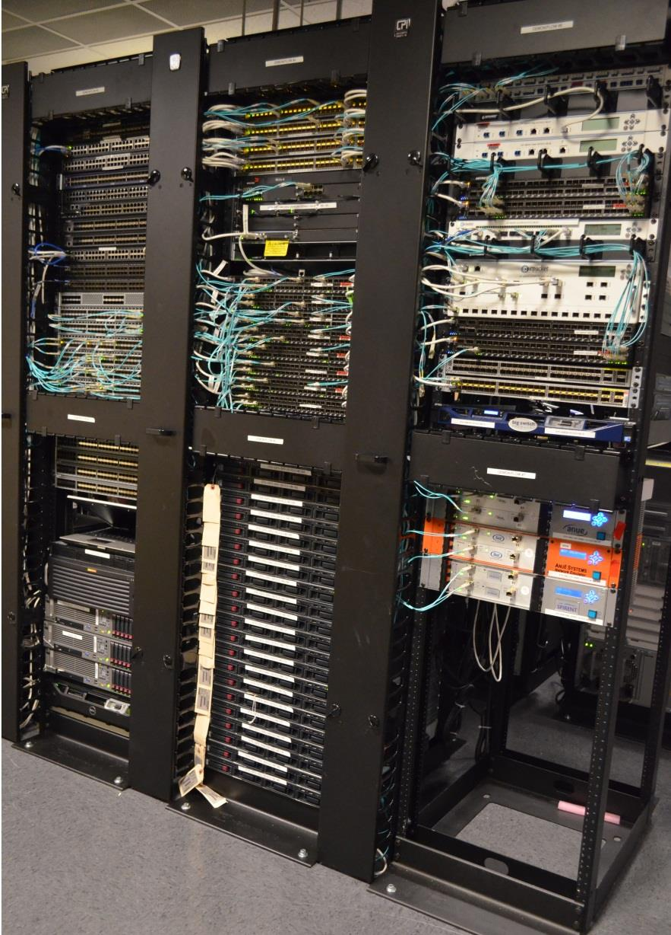
Benefits of SDN Control Planes
Achieving High Utilization with Software-Driven WAN |  | Link
Ratul Mahajan et. al. (Microsoft) | ACM SIGCOMM 2013
Prototype:
16 OpenFlow switches
Mix of Blades and Aristas
BigSwitch OpenFlow controller
32 servers as traffic sources
25 virtual hosts per server
8 routers (L3)
Mix of Cisco and Juniper

Slide 27
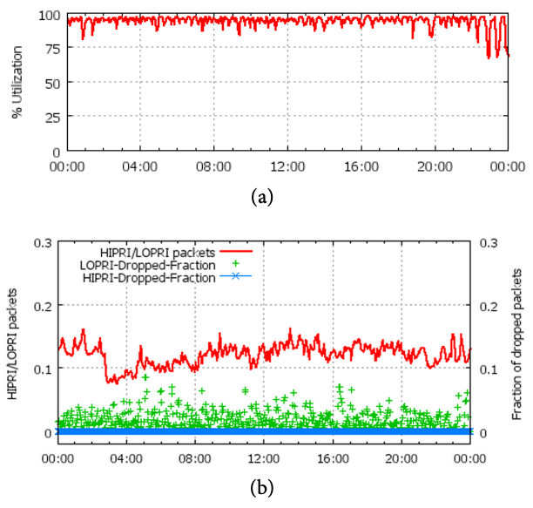
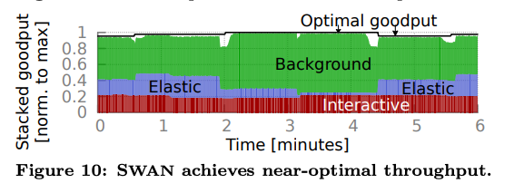
Benefits of SDN Control Planes
SDN control planes leads to very efficient usage of network resources.
SDN also lets us implement custom policies (e.g. prioritizing certain traffic) to improve performance.
Notes:
https://cseweb.ucsd.edu/~vahdat/papers/b4-sigcomm13.pdf
https://conferences.sigcomm.org/sigcomm/2013/papers/sigcomm/p15.pdf

Slide 28
Drawbacks of SDN Control Planes
Reliability.
Traditional networks: If one link fails, routers adapt and re-converge.
SDN networks: If the controller fails, the network stops updating. Routers can't adapt to changes.
Scalability.
Central controller must deal with decisions for everybody.
Complexity.
Infrastructure challenge: Where do we put the controller?
How do we reliability connect the controller to the routers?
Active area of research!

Slide 29
SDN in Datacenters
Software-Defined Networking
A Brief History
Implementation (OpenFlow API)
Benefits (Traffic Engineering)
SDN in Datacenters
Other Applications of SDN
Lecture X, CS 168, Fall 2024

Slide 30
SDN in Datacenters – Overlay
Recall: Encapsulation in datacenters.
We add a virtual network ID header to distinguish between tenants.
We add an underlay header with the destination's physical address.
SDN lets us program servers to implement these headers.
The central controller can tell the servers:
"192.0.2.2 Pepsi VM created on Server 2.2.2.2."
"Coke network ID is 42."
To: 2.2.2.2
P
To: 192.0.2.2
Payload
Overlay
Server 1 1.1.1.1
Server 2 2.2.2.2
192.0.2.1
192.0.2.1
192.0.2.2
192.0.2.2
P1
C1
P2
C2
Virtual Switch
Virtual Switch
Underlay
R1
R2
R3
R4

Slide 31
SDN in Datacenters – Overlay
SDN handles distributing custom information in datacenters.
Example: Virtual network IDs.
This information would otherwise have to be in the router's control plane.
SDN allows the underlay of the network to remain simple.
SDN maps overlay virtual addresses to underlay physical addresses.
No need for the underlay to understand virtual addresses.
SDN allows the control plane to be extended to servers (e.g. virtual switches).
Simpler mechanism for programming servers.
No need to implement routing protocols for encapsulation.

Slide 32
SDN in Datacenters – Underlay
The SDN underlay network is a physical network, just like any other.
The benefits from earlier (simplicity, efficiency) apply to the underlay network too.
Hyperscale datacenters might use SDN in both the overlay and underlay.
But these are decoupled systems.
Per-flow load balancing might cause 2 elephant flows to share a link.
A global controller can route traffic differently, improving performance.

Slide 33
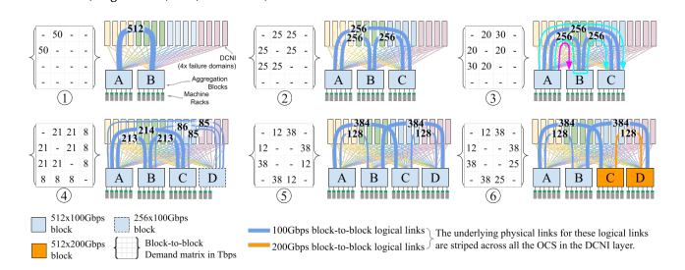
Improving Efficiency of Datacenters Using SDN
Elimination of stages in a Clos topology by adding dynamic links.
Enabled by SDN.
Jupiter Evolving: Transforming Google's Datacenter Network via Optical Circuit Switches and Software-Defined Networking |  | Link
Leon Poutievski et. al. (Google) | ACM SIGCOMM 2022

Slide 34
Other Applications of SDN
Software-Defined Networking
A Brief History
Implementation (OpenFlow API)
Benefits (Traffic Engineering)
SDN in Datacenters
Other Applications of SDN
Lecture X, CS 168, Fall 2024

Slide 35
SDN in Wide-Area Networks (WAN)
The benefits of traffic engineering (e.g. efficiency, simplicity) apply to general WANs as well.
Example: SDN control planes let us use expensive network resources (e.g. undersea cables) more efficiently.
Send 10 Gbps to R2, and 2 Gbps to R6.
A → C = 12 Gbps
A
R1
R2
R4
C
B → C = 8 Gbps
B
R5
R6
R7
All links 10 Gbps.

Slide 36
Innovating Routers
The management plane is loosely standardized.
Recall: The management plane is how operators configure and monitor routers.
Often a bottleneck for network operations.
Historically, less focus on this plane.
Slow evolution toward using scripts to programmatically control the network.
SDN lets us try new approaches to management, too.
One of SDN's lessons is well-defined, programmatic APIs.
This lesson also applies to the management plane.
Developed by an equipment vendor.
Management Plane
Control Plane
Data Plane

Slide 37
"SDN" in the Management Plane
Manifested itself as more software being used in networking.
Key ideas:
Data modeling: YANG (IETF data modeling language).
OpenConfig: Use of standardized APIs to interact with the management plane.
Similar to what OpenFlow did for the control plane.
Not part of the original SDN vision, but something that has evolved during its implementation.

Slide 38
SDN in the Data Plane?
SDN has mostly focused on the control plane.
Relatively standard set of lookup tables and behaviors available.
Other than in software-based data planes. (low-scale!)
What happens if the dataplane is the inflexible part?
Programming Protocol-Independent Packet Processors (P4)
Open-source, domain-specific language for telling a device how to process packets.
Programmability at the data plane.
Some challenges:
Fixed functionality forwarding chips (needed for speed) are not arbitrarily flexible.
Programmable chips are lower performance, and higher cost.

Slide 39
Summary: SDN
SDN evolved from inflexibility of the control plane to meet different operational requirements.
It splits the control and data planes to make the control plane more flexible.
There are applications across both WAN and datacenter networks.

